Slide 1
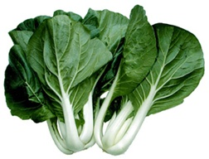
Growing Bok Choy (Brassica rapa Chinensis group) on Guam
Source: https://www.health-alternatives.com/images/bokchoy.jpg

Slide 2
Bok choy cultivated since the 5th century in Asia
Can be found growing in many countries today
It is 1 of two main types of Chinese Cabbage cultivated for consumption
  Bok Choy – Chinensis group – loose leaf, non-heading Chinese cabbage
    Other names – pak choi, pai-tsai, and more
    Some names crossover with names of Chinese cabbage from Pekenensis group
  Pe-tsai – Pekenensis group – broad leaf, compact-heading type
Cultivated ‘here and there’ on Guam over 30 years
Cool-season crop.
Best grown in 55-70°F. Many varieties can handle hotter temperatures like Guam

Slide 3
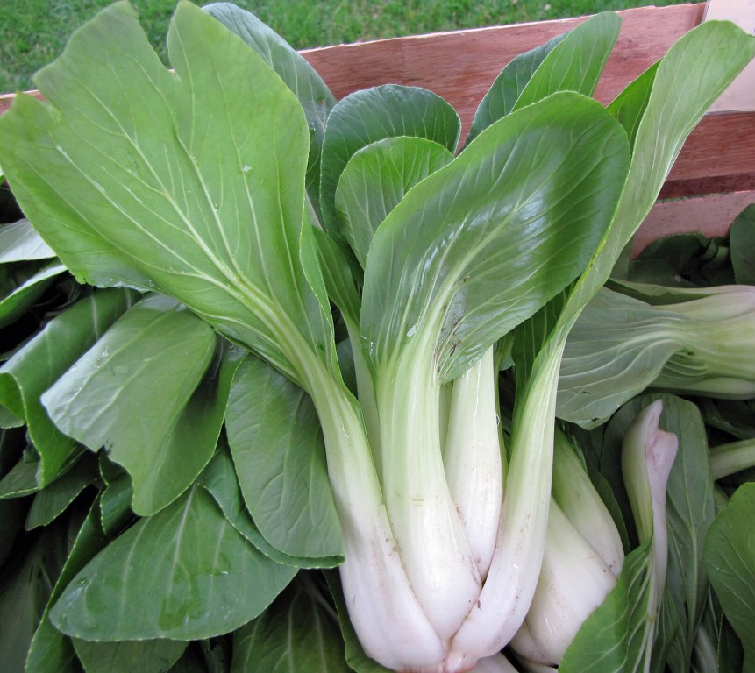
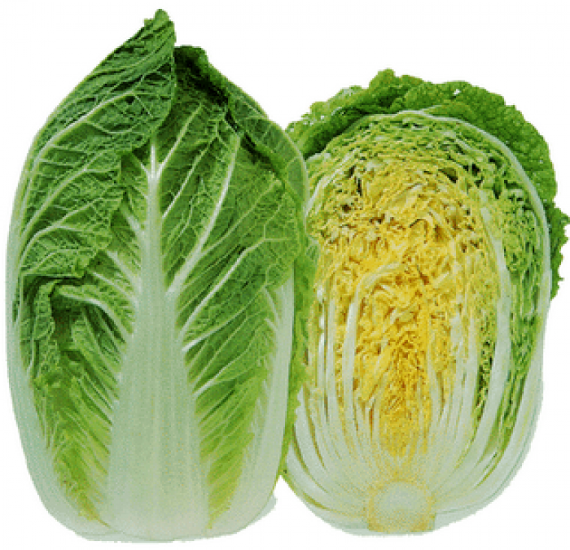
Bok Choy (Brassica rapa Chinensis group)
Pe-tsai / Napa (Brassica rapa Pekenensis group)
https://www.urbanseedling.com/product/asian-greens-bok-choi-shanghai-green/
http://www.cor.ca/view/290/chinese_cabbage.html

Slide 4
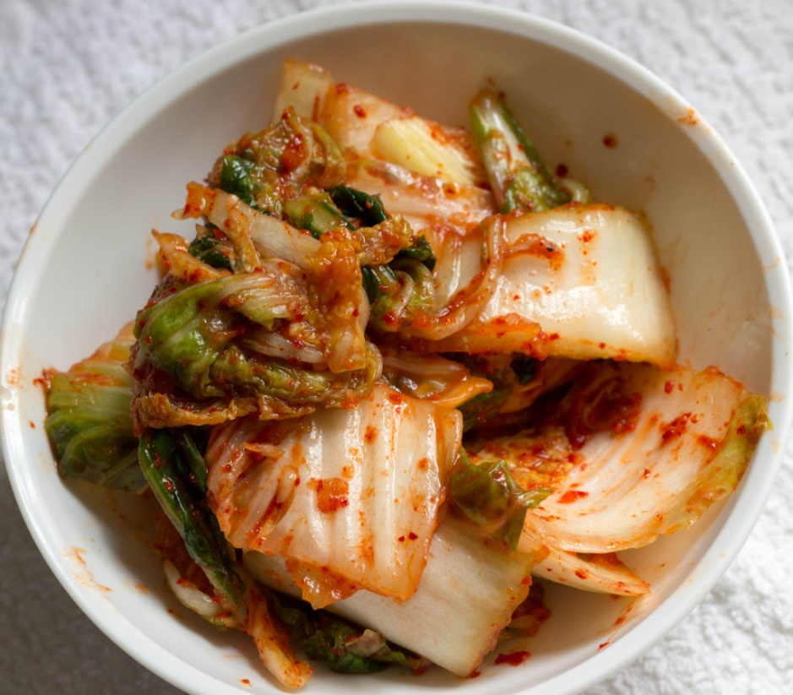
Bok choy is used for many types of food dishes
Salads
Stir-fry
Kimchi/Kimchee
http://barrycampbell.org/2014/03/23/kimchee/

Slide 5
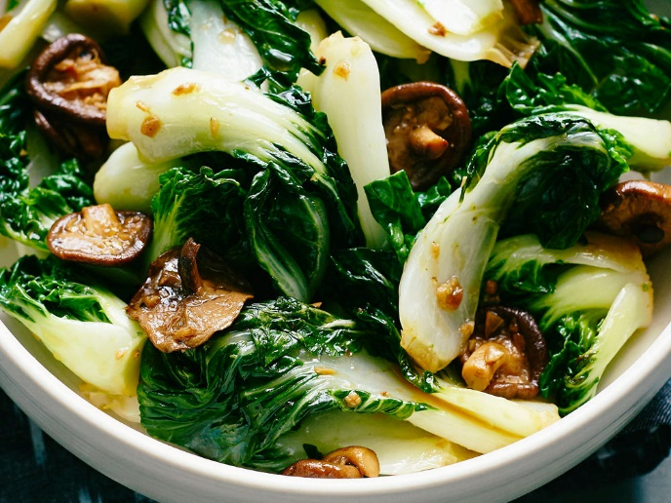
Health Benefits of Bok Choy
Low in saturated fat and cholesterol
Good source of dietary fiber, protein, thiamin
Good source of vitamins A, K, C, B6
https://tinyurl.com/y6uq94jp

Slide 6
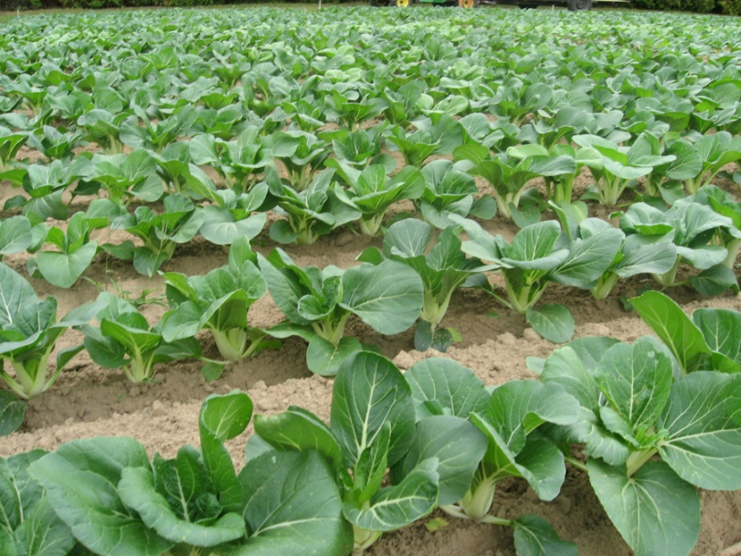
Growing Bok Choy
For the tropics, choose heat-tolerant and slow-bolting varieties (early flowering/bolting will result in bitter flavor)
Grows best in fertile, well-draining soils with high organic matter (preferred pH – 5.8-7.5)
Irrigation – frequent watering ensuring constant moisture, but not saturated soils
https://tinyurl.com/y7sjler3

Slide 7
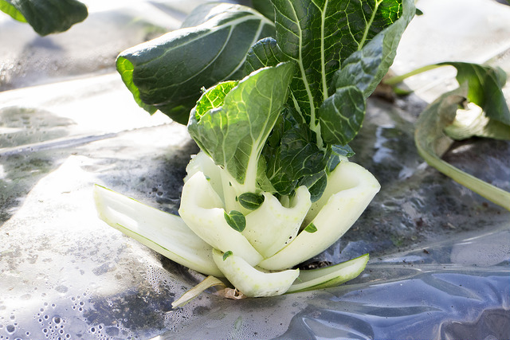
Growing Bok Choy
Depending on Variety
In open fields, 8-20 inches between plants on beds (up to 4 rows per bed) and 2-4 ft between beds apart depending on variety
Individually at desired spacing in containers
Usually harvested at 30-60 days after germination (before flowering/bolting)
  Whole plants usually harvested as a one-time harvest
  ‘Cut and Come Again’ harvest method can be used
https://brooklynfarmgirl.com/2014/05/22/time-to-pick-bok-choy-in-the-garden/

Slide 8
Plant care
Ensure soil is moist most of the time, not saturated
Well-draining soils are best with pH ranging from 5.8 – 7.5
For small-scale, any complete fertilizer can be used, but should be applied appropriately
For commercial - General Fertilizer recommendation
  1500 lbs of 10:10:10 (N-P-K) per acre
  3.5 lbs of 10:10:10 (N-P-K) per 100 sq ft.
Consult with local cooperative extension service

Slide 9
Plant care
Monitor for pest and diseases
Collect samples if possible
Consult with knowledgeable professional on pest and disease management
Weeding, mulching recommended
Good record-keeping

Slide 10
Post Harvest
Bok Choy should be cooled as soon as possible to reduce water loss.
Best stored at 32°F for 3 weeks at 95-100% relative humidity, and although this reduces water loss, chilling injury will begin to appear after that period.

Slide 11
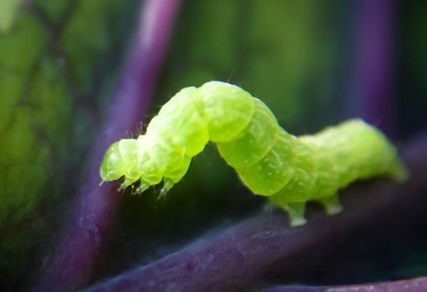
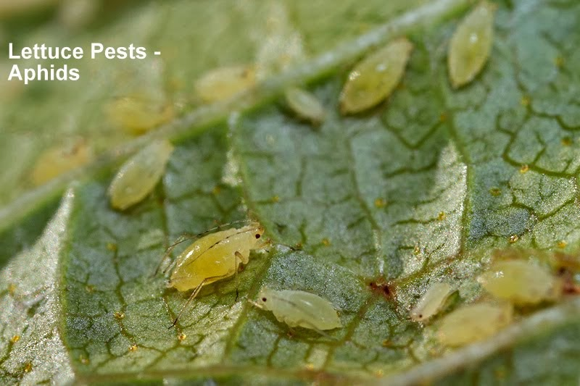
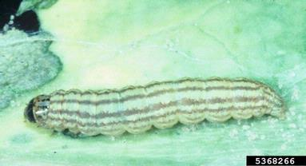
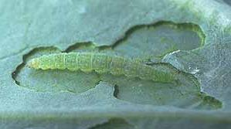
Some Pests of Bok Choy
Cabbage looper (Trichoplusia ni)
Aphids (Family: Aphididae)
Cabbage looper (Trichoplusia ni)
http://www.dankgardener.com/learn-and-grow/gallery.html?idx=1&albid=5967847605486742785&back=article
https://www.planetnatural.com/pest-problem-solver/garden-pests/cabbage-looper-control/
Cabbage webworm (Hellula undalis)
Diamondback moth(Plutella xylostella)
http://lepidoptera.butterflyhouse.com.au/glap/undalis.html
http://lepidoptera.butterflyhouse.com.au/plut/xylostella.html

Slide 12
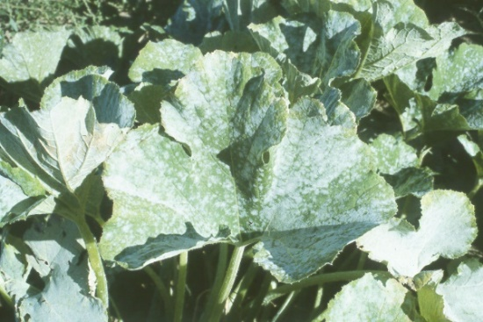
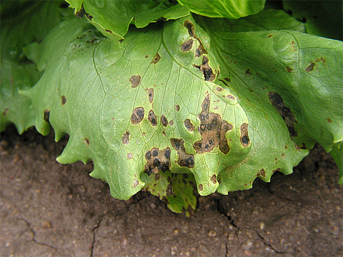
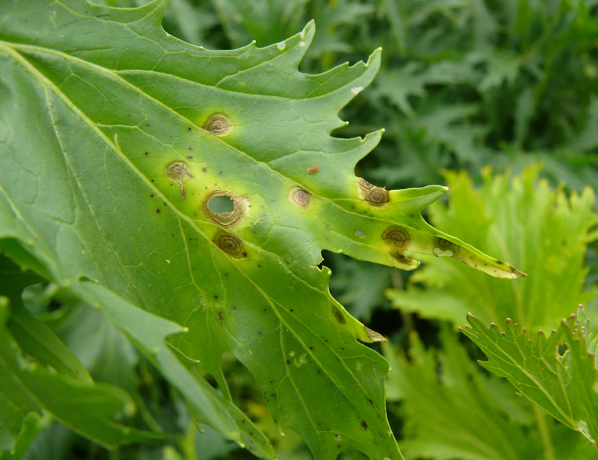
Some Diseases of Bok choy
Powdery Mildew (Sphaerotheca spp.) (fungus)
Black Rot (Xanthomonas campestris) (bacterium)
http://mtvernon.wsu.edu/path_team/DiseaseGallery/dg81L.jpg
http://gardener.wikia.com/wiki/File:Lettuce_Bacterial_leaf_spot_Xanthomonas_campestris_pv._vitans3.jpg
Leaf spot (Alternaria brassicae) (fungus)
http://www.omafra.gov.on.ca/CropOp/en/spec_veg/brassicas/bokc.html

Slide 13
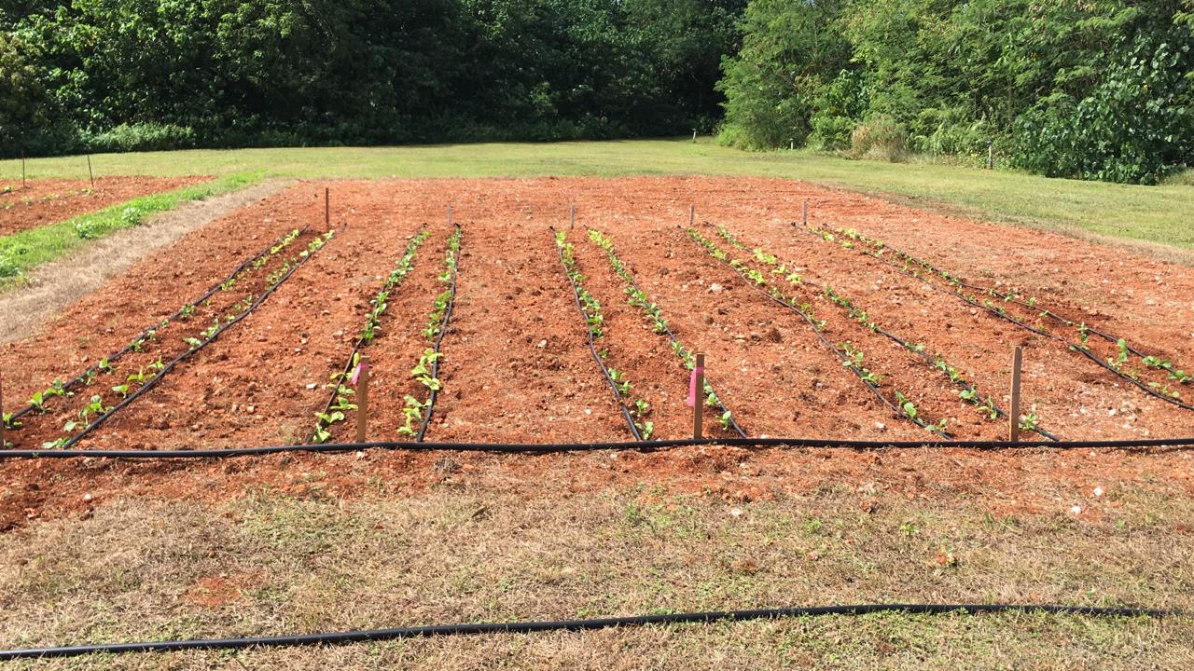
Evaluation of 4 Bok Choy varieties on local soil type Guam Cobbly Clay Loam - Focusing on yield (weight/marketability)
Western Pacific Tropic Research Center, Yigo Experiment Station, University of Guam
January 9 - 29, 2018

Slide 14
Plants were grown in Sunshine Mix #4 Potting Media in plant trays for 17 days before transplanted into individual 1-gallon pots into treatments.
Plants grew in open field from January 9 -29, 2018
Individual plants were harvested and measured for fresh weight and marketability

Slide 15
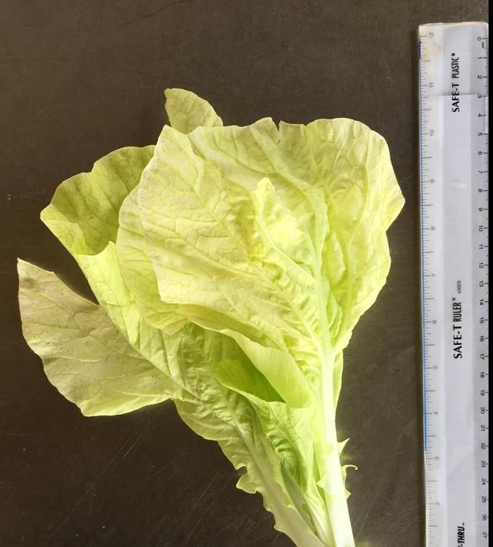
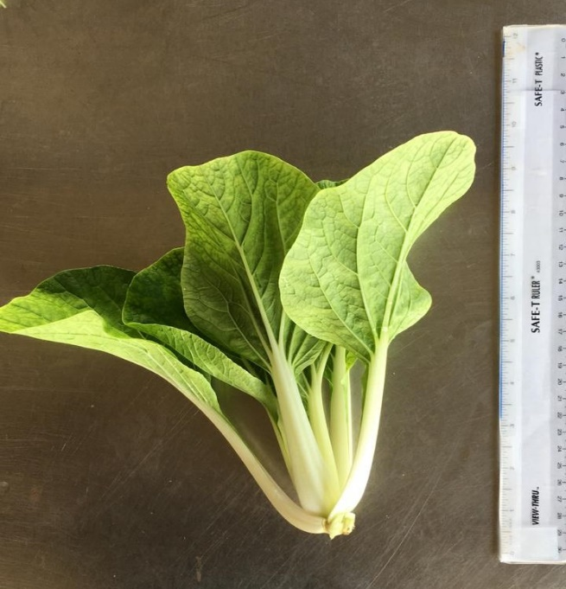
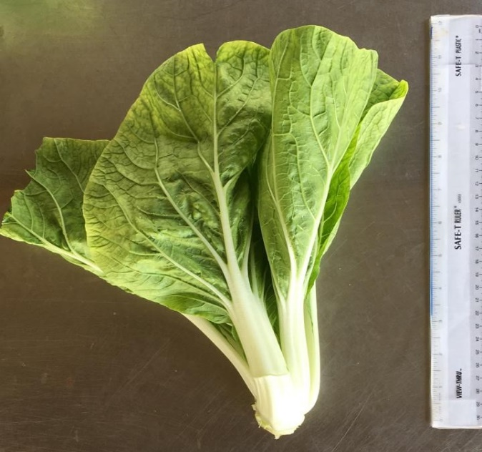
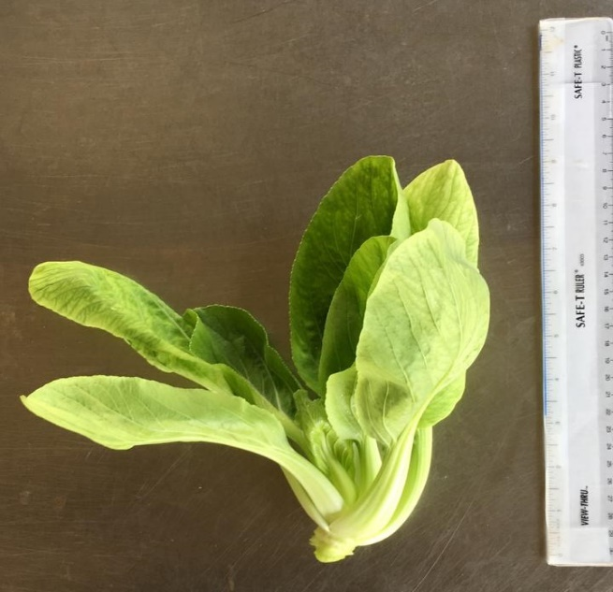
Varieties
F1 Hybrids
San Feng
Gracious
Bino
Brisk Green

Slide 16
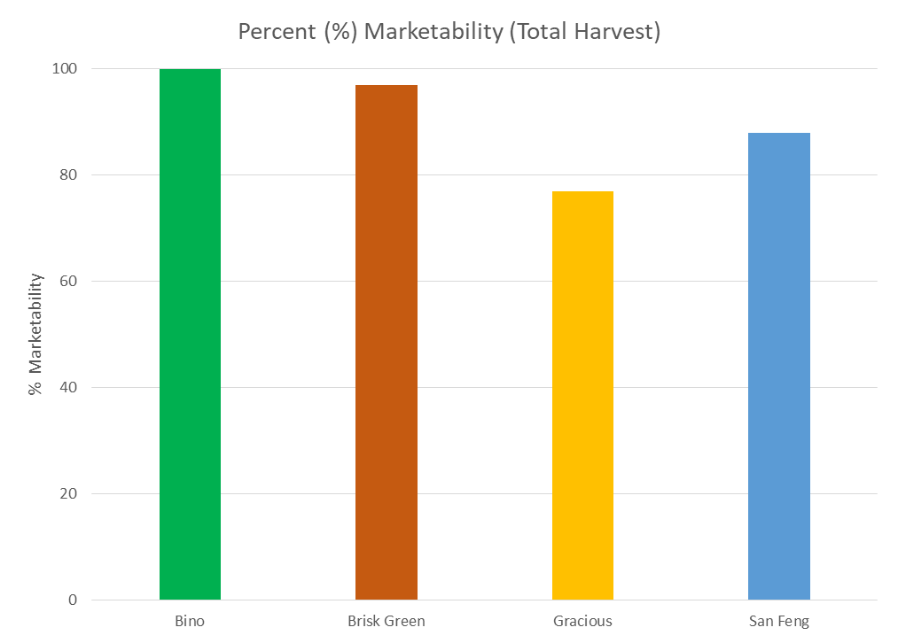

Slide 17
Bok Choy Variety | Average weight of individuals from Guam Trial (lbs.) | Average weight of individuals from Known You Seed Company (lbs.)
Bino | 0.51 | 0.44
Brisk Green | 0.28 | 0.35
Gracious | 0.31 | 0.39
San Feng | 0.45 | 0.44

Slide 18
Discussion
All varieties produced quality cabbage heads with high marketability
San Feng and Bino resulted in similar weights as advertised by seed company
Gracious and Brisk Green resulted in slightly lighter weights than weights advertised by seed company possibly due to early worm damage.
Choose heat-tolerant bok choy varieties
Keep soils moist all the time to keep soil temperature cool
Monitor plants at least once or twice a week

Slide 19
References
Kelley, W.T. 1999. Specialty Crops: Chinese Cabbage and Related Oriental Crops. Commercial Vegetable Production. Circular 809. Cooperative Extension Service, University of Georgia College of Agricultural & Environmental Sciences. 8p.
Kitinoja, L. and Adel, A.K. 1995. Small-scale Postharvest Handling Practices – A Manual for Horticultural Crops. 3rd edition. Section 7: Storage of Horticultural Crops. Postharvest Horticulture Series No.8. Department of Pomology, University of California–Davis. 27p.
Self Nutrition Data. 2014. Cabbage, Chinese (pak-choi,) Raw Nutrition Facts & Calories. Retrieved from http://nutritiondata.self.com/facts/vegetables-and-vegetable-products/2377/2
Stephens, J.M. 2015. Cabbage, Chinese-Brassica campestris L. (Pekinensis group), Brassica campestris
L. (Chinensis group). HS569. IFAS Extension, University of Florida. 3p.

